Slide 1
RC B-O-T

Slide 2
A WIRELESS rEMOTE controlled bot WITHOUT A MICRO-CONTROLLER
An RF transmitter and receiver module is coupled with HT12E and HT12D.
This transfers the data over the air to the motor driver L293D with the help of a NOT Gate.

Slide 3
THINGS WE NEED?
DC GEARED MOTORS
WHEELS
WOODEN CHASSIS
DPDT SWITCH
L293D MOTOR DRIVER IC
HT12E – ENCODER IC
HT12D – DECODER IC
NOT GATE
RF Rx-Tx MODULE
7805 – 5V Regulator IC
9V BATTERY PACK (2)
BOT
REMOTE CONTROLLER

Slide 4
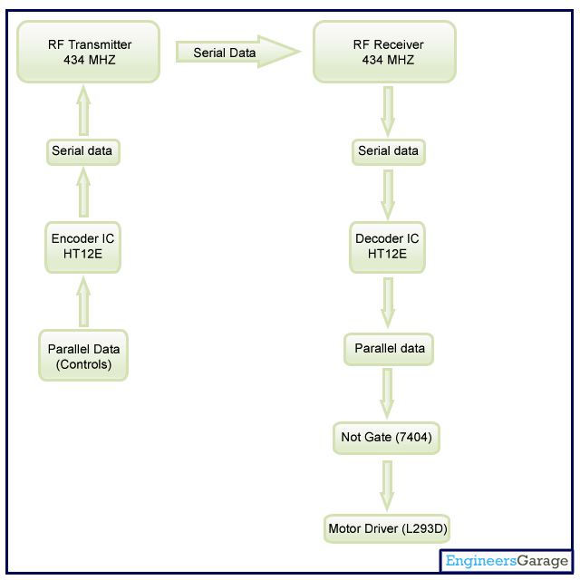
SO, how does it work?
Two main logic blocks.
Transmitter and Receiver.
Data from the Encoder is transmitted via the transmitter in a serial manner.
The receiver sends the data to the decoder which converts the serial data to parallel.
The parallel data is fed to the NOT GATE which in turn is fed to the MOTOR DRIVER.

Slide 5
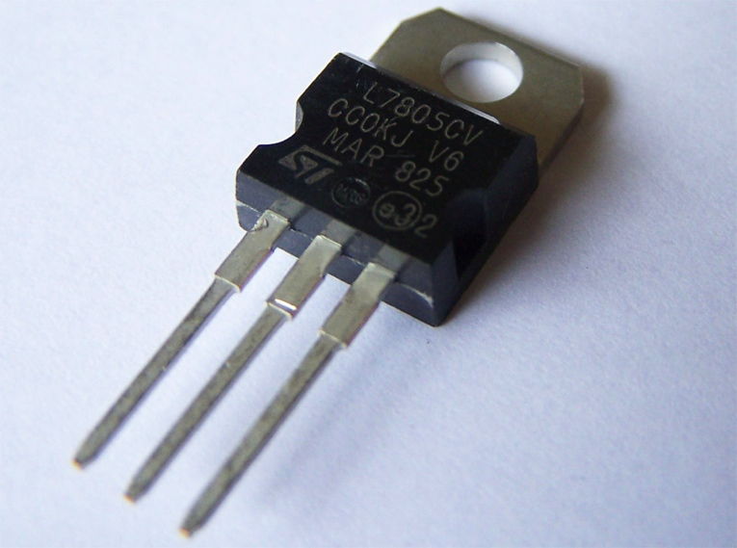
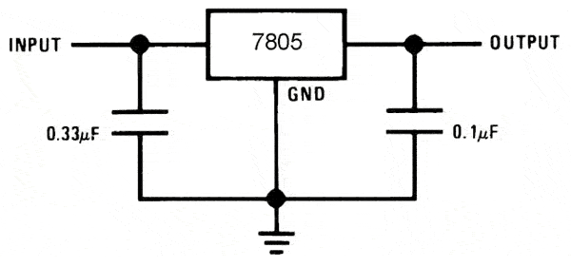
Voltage regulator
The voltage source in a circuit may have fluctuations and would not give the fixed voltage output.
This may damage due to fluctuations.
The AC power supply gets converted into constant DC by this circuit.
The voltage regulator IC maintains the output voltage at a constant value

Slide 6
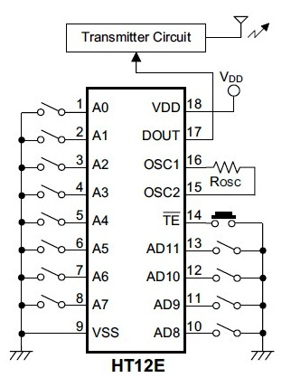
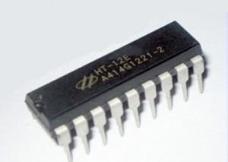
HT12e Encoder
It is an Encoder integrated circuit of 2^12 series of encoders.
Converts parallel inputs into serial output.
It encodes the 12 bit parallel data into serial for transmission through an RF transmitter.
These 12 bits are divided into 8 address bits and 4 data bits.

Slide 7
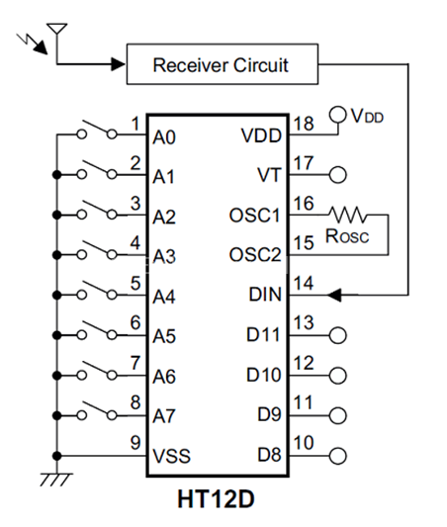
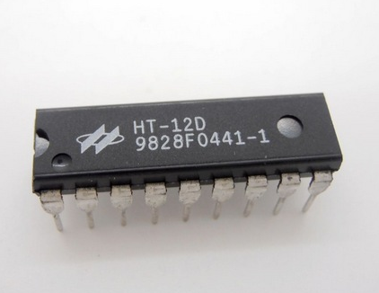
Ht12d decoder
The address pin in the decoder behaves just like that of the the encoder.
The data is received at the DIN pin from the RF receiver circuit.
This data is checked thrice and then decoded and IC checks if the address pin connection of the encoder is same as that of the decoder.
If and only if the address matches, the data is decoded and latched on to the data pins (D8 to D11).

Slide 8
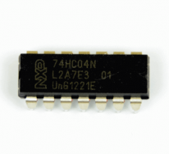
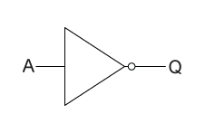
NOT gate
Finally, our very own NOT GATE.
It deals with single input data signal.
It inverts the input data from the decoder and sends the output data
to the MOTORDRIVER.

Slide 9
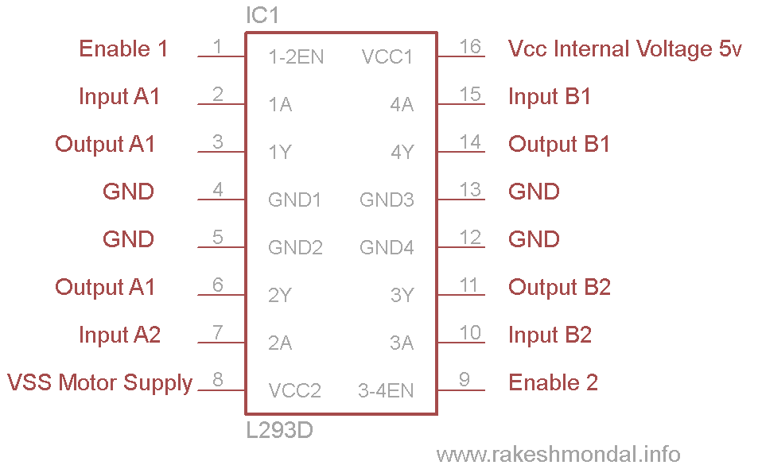
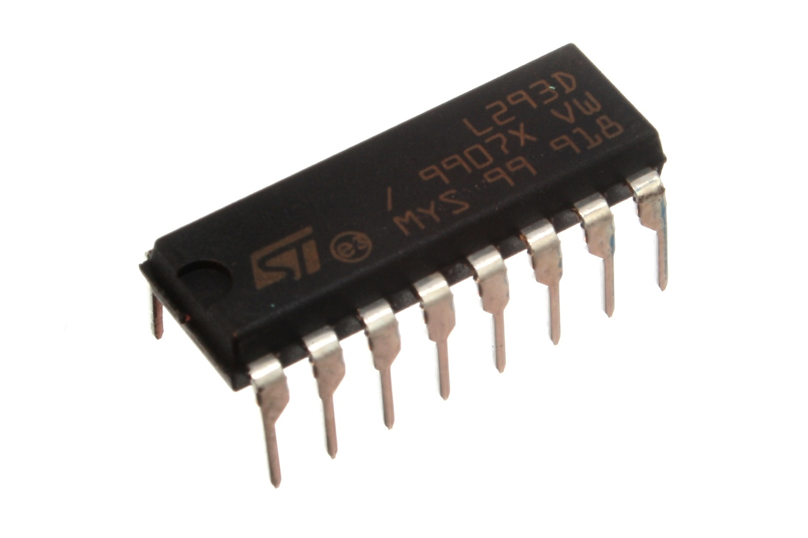
Motor driver l293D
L293D is a dual H-bridge motor driver.
It drives the motor in both forward and backward directions.
It is a 16 pin IC which can control two geared DC motors simultaneously.

Slide 10
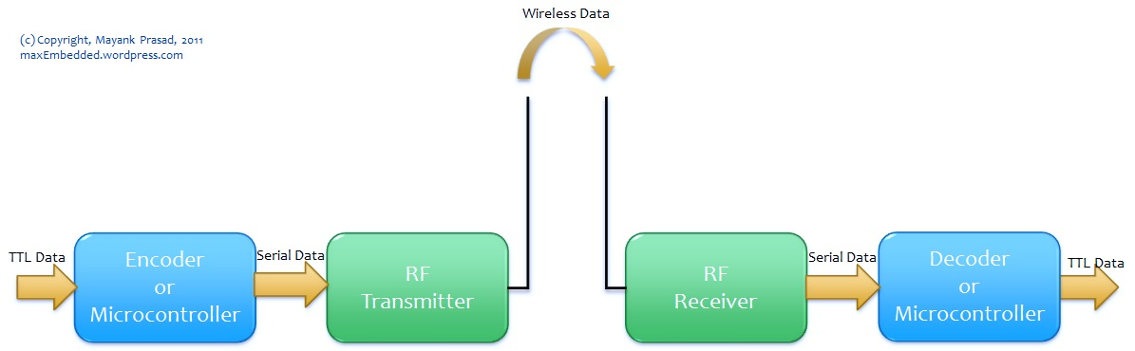
RF Module
A Radio Frequency module transmits and receives radio signals within two devices.
It consists of a Transmitter and a Receiver
RF Modules are used wireless transfer data.

Slide 11
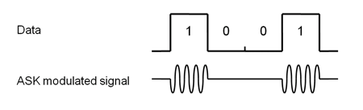
Amplitude shifting key
What is Amplitude Shifting Key?
ASK - is a modulation process,
It imparts to a sinusoid two or more discrete amplitude levels.
For a binary message sequence there are two levels, one of which is typically zero.
Thus the modulated waveform consists of bursts of a sinusoid.
￼

Slide 12
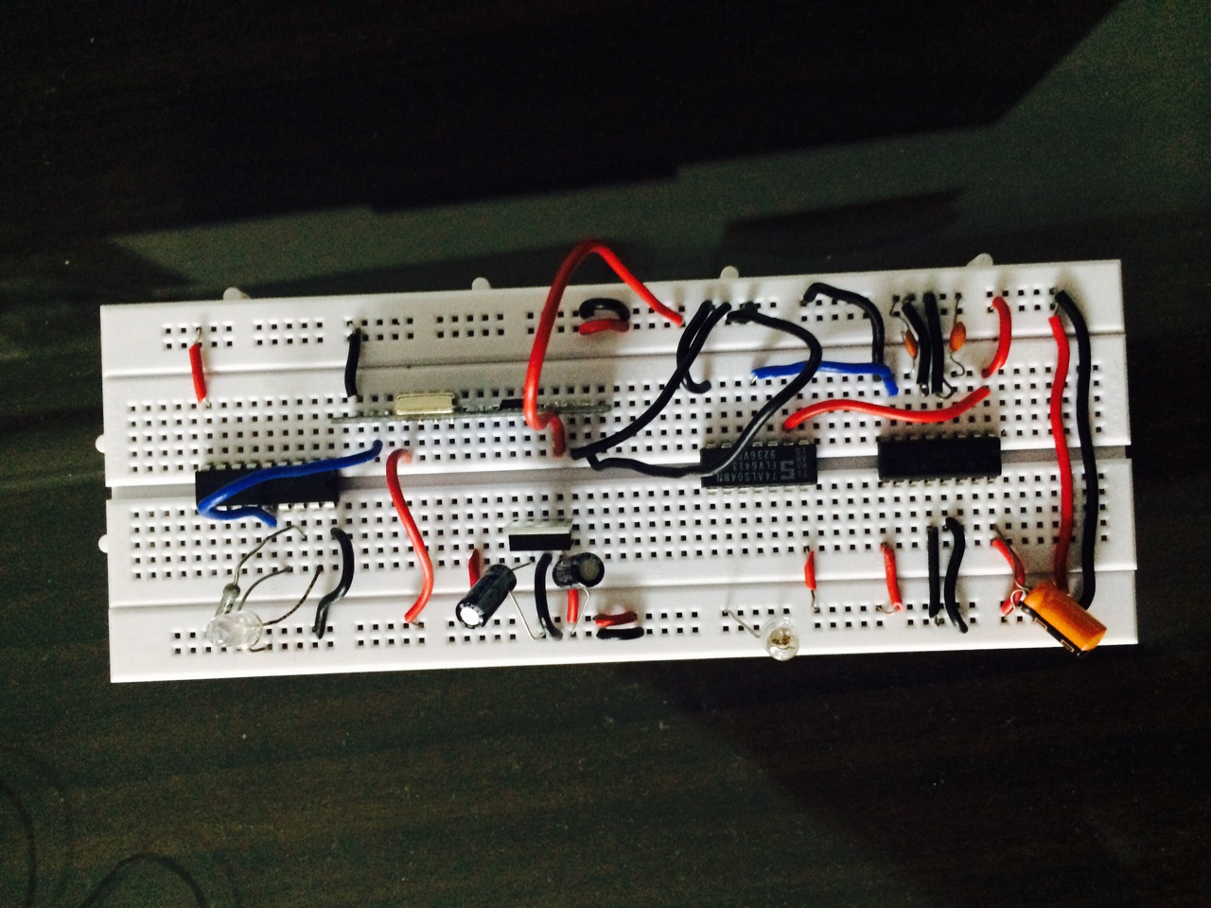
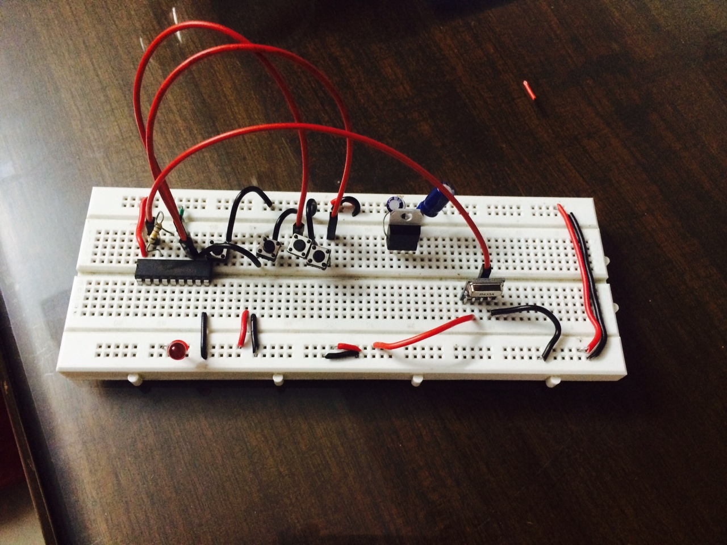
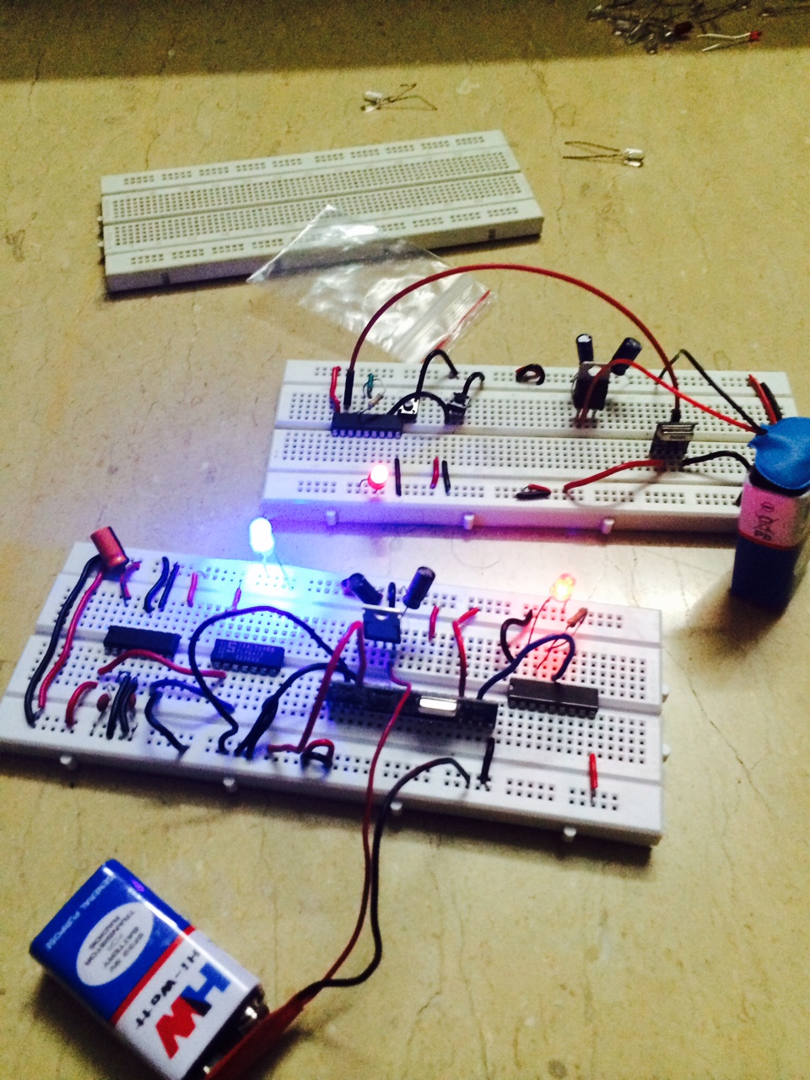
The making..!

Slide 13
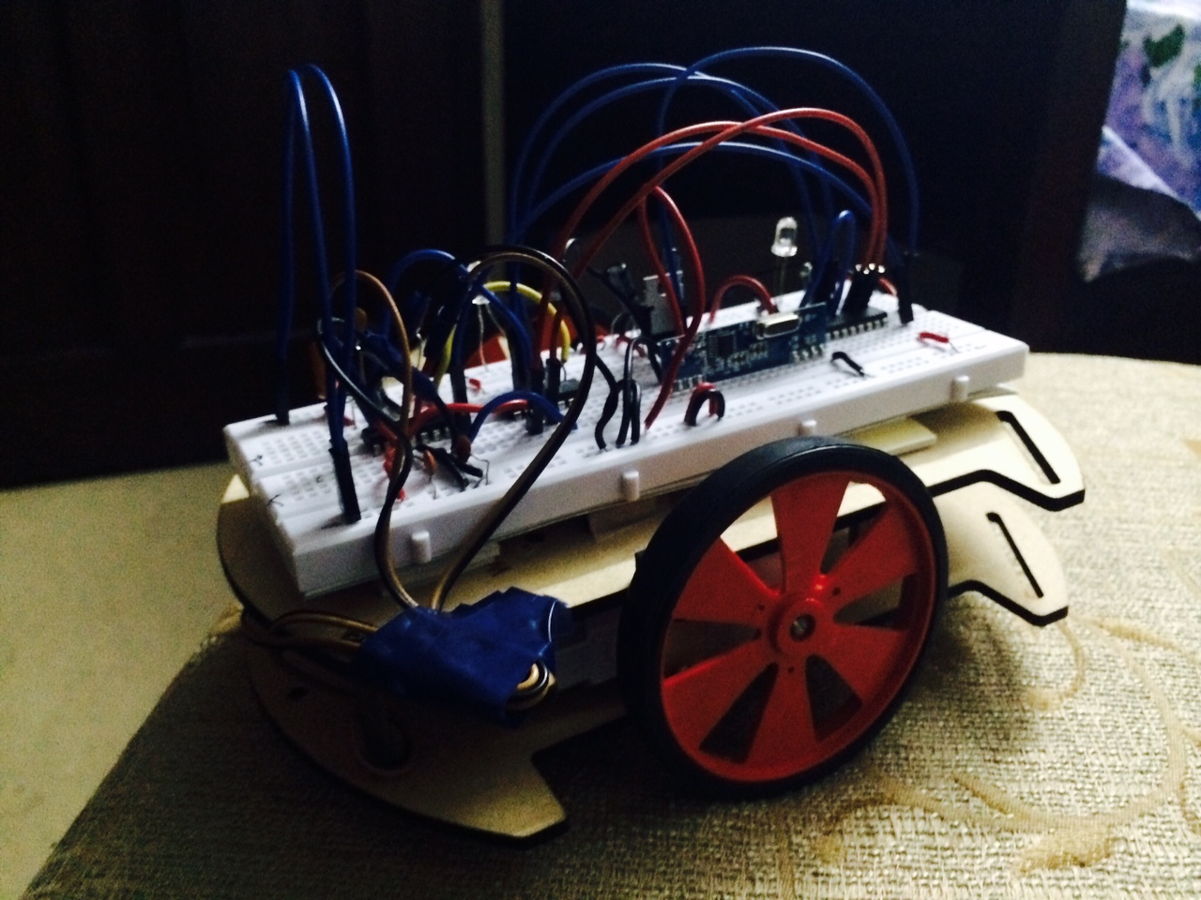
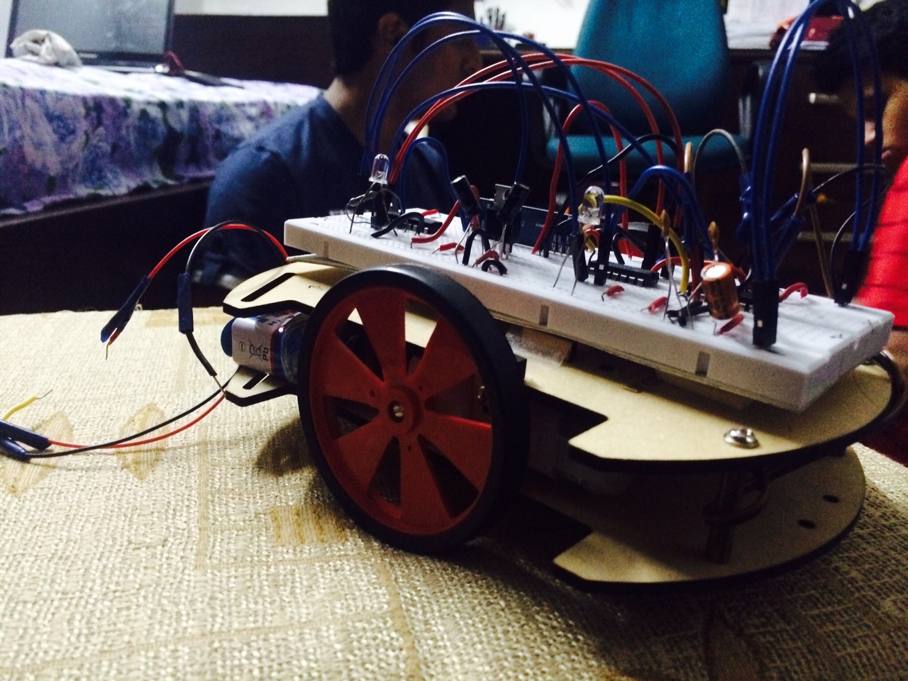
IT’S DONE..!!!

Slide 14
participants
Shankar Sridhar – ECE C
Vishal Baskar – ECE C
Prashanth T V – ECE B

Slide 15
ACKNOWLEDGEMENTS
We would like to Thank our HOD, Professors, Staffs ,Sub Staffs and all our Seniors for helping us.

